Slide 1


Lesson PowerPoint Presentation for…
How did the Stamp Act Increase Tensions in the colonies?
TEACHING DEMOCRACY
August 15, 2012
Kate Bowen
Patwin Elementary School

Slide 2
The Declaratory Act, 1766
“…the King's majesty, by and with the advice and consent of the lords spiritual and temporal, and commons of Great Britain, in parliament assembled…and of right ought to have, full power and authority to make laws and statutes of sufficient force and validity to bind the colonies and people of America, subjects of the crown of Great Britain, in all cases whatsoever.…”
Notes:
From http://avalon.law.yale.edu/18th_century/declaratory_act_1766.asp.

Slide 3
The Stamp Act - Review
The French and Indian War was very costly for the British
Parliament needed to find a way to make money to pay off the debts
Parliament passed a series of taxes on the colonists
These taxes were called Acts
Colonists felt that these taxes were unfair

Slide 4
The Stamp Act - Review
The Stamp Act in 1765 was the first direct tax on the colonists
The Stamp Act affected all of the paper in the colonies
Every document, letter, newspaper, and license had to be stamped with the correct stamp which cost money
Lawyers and newspaper publishers were hit especially hard by the tax

Slide 5
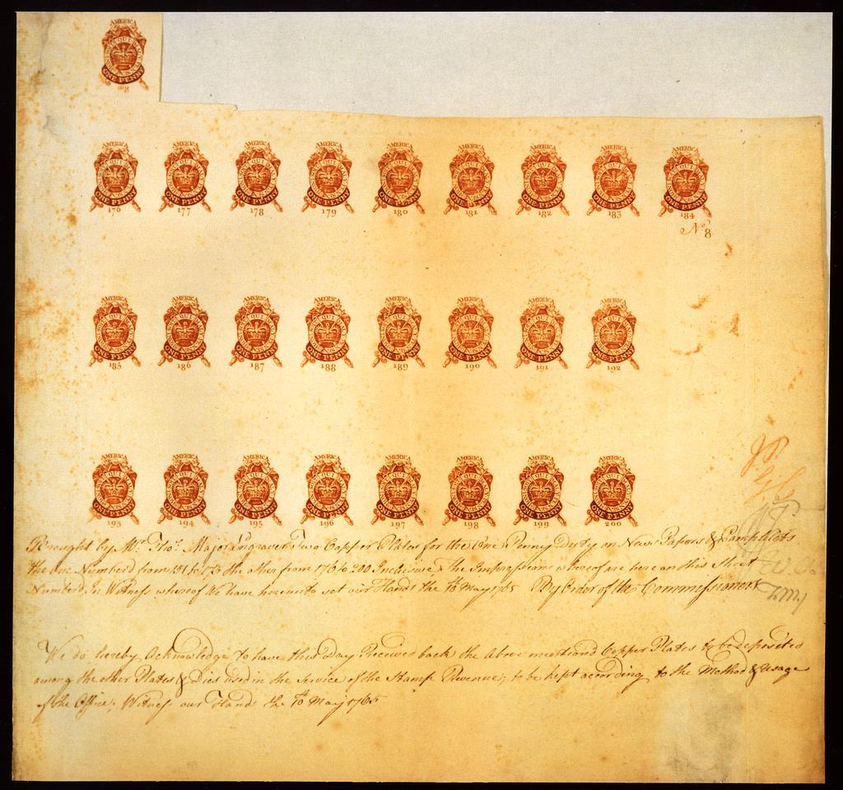
A Sheet of Royal Stamps
Source: Proof Sheet of 1d Stamp Duties for Newspapers,” 1765. Board of Inland Revenues Stamping Department Archive, Philatelic Collection, The British Library (34). Accessed from the Library of Congress, http://www.loc.gov/exhibits/british/images/34uc.jpg

Slide 6
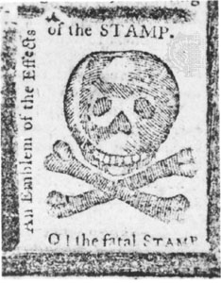
Stamps by Colonists
The skull and crossbones stamp was actually a political cartoon that was printed on newspapers to mark the place where the stamp was to be
This stamp showed the hatred for the Stamp Act
http://www.loc.gov/pictures/item/2004672606/

Slide 7
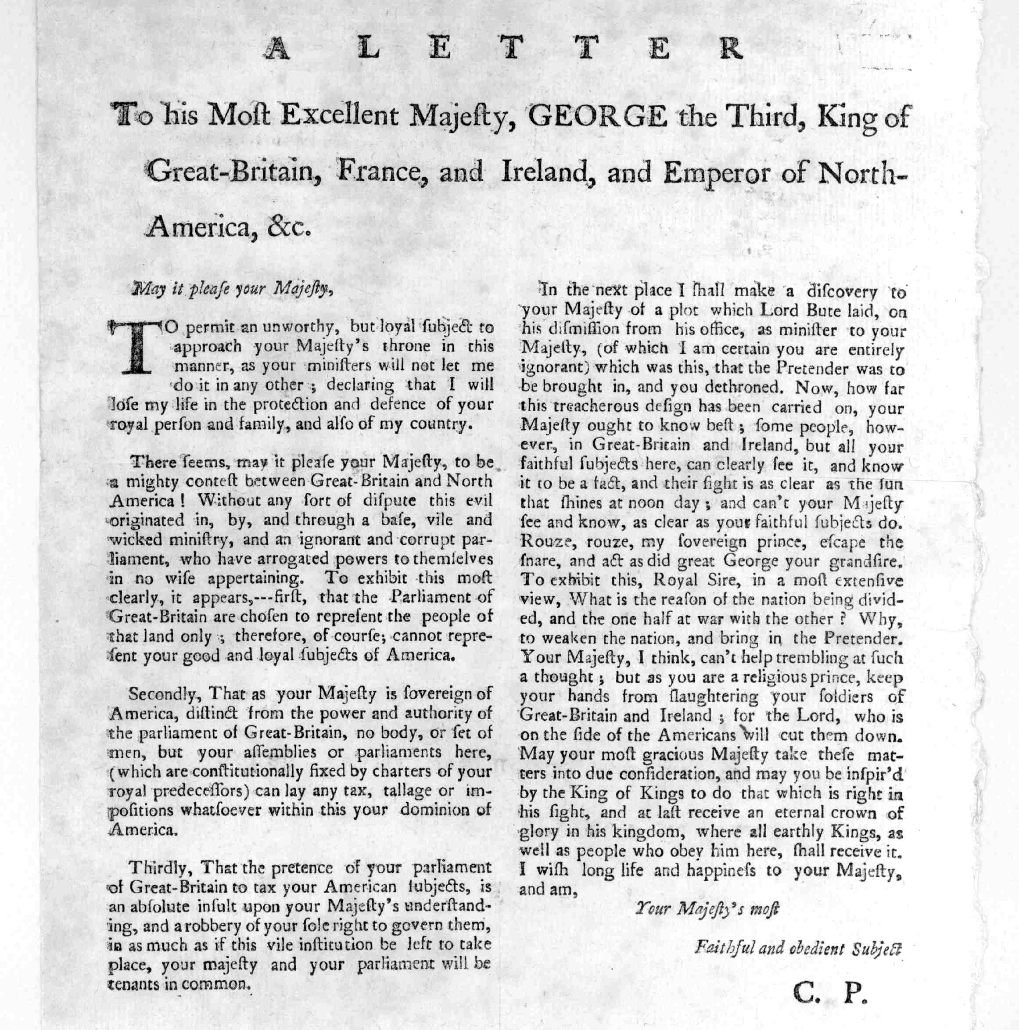
Letter to King George, 1865
From the Library of Congress, Rare Book and Special Collections Division, http://hdl.loc.gov/loc.rbc/rbpe.1020400b.

Slide 8
A Letter to his Most Excellent Majesty, King George
May it please your Majesty,
…There seems…to be a mighty contest between Great-Britain and North America! Without any sort of dispute this evil originated in, by, and through an ignorant and corrupt parliament, who have arrogated (claimed) powers to themselves... To exhibit this most clearly, it appears,--first, that the Parliament of Great-Britain are chosen to represent the people of that land only; therefore, of course; cannot represent your good and loyal subjects of America…
… the pretence (behavior) of your parliament of Great-Britain to tax your American subjects, is an absolute insult…and a robbery of your sole right to govern them, in as much as if this vile institution be left to take place, your majesty and your parliament will be tenants in common (two or more people owning the same property)…
…May your most gracious Majesty take these matters into due consideration, and may you be inspir'd…to do that which is right in his sight…I wish long life and happiness to your Majesty, and am,
Notes:
the Library of Congress, Rare Book and Special Collections Division, http://hdl.loc.gov/loc.rbc/rbpe.1020400b.
Student Handout 1A: Excerpts from a Letter to King George

Slide 9
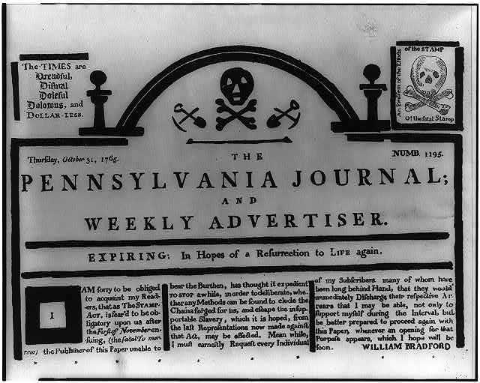
Masthead of a Pennsylvania Newspaper
From the Library of Congress, http://www.loc.gov/pictures/item/2004672607/

Slide 10
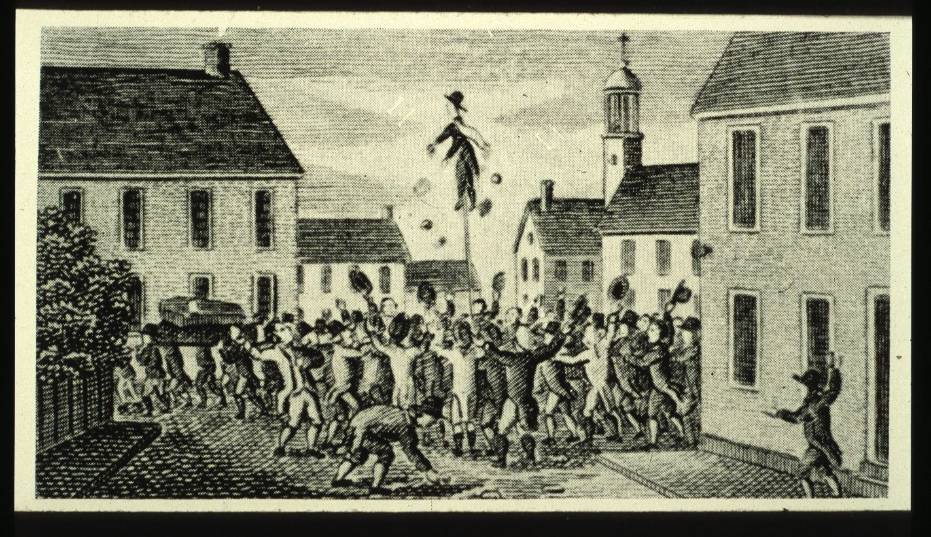
Effigy of Stamp Distributor
From the Alan Taylor Collection of the Marchand Image Collection
http://historyproject.ucdavis.edu/marchandslides.bak/taylor_alan/images/Rev-p02-a01.jpg

Slide 11
Stamp Act Congress
I. That his Majesty’s subjects in these colonies, owe the same allegiance to the Crown of Great Britain, that is owing from his subjects born within the realm, and all due subordination to that august body, the Parliament of Great Britain.

Slide 12
Stamp Act Congress
III. That it is inseparably essential to the freedom of a people, and the undoubted right of Englishmen, that no taxes should be imposed on them, but with[out] their own consent given personally, or by their representatives.

Slide 13
Stamp Act Congress
V. That the only representatives of the people of these colonies, are persons chosen therein, by themselves; and that no taxes ever have been, or can be constitutionally imposed on them, but by their respective legislature.

Slide 14
Stamp Act Congress
XIII. That it is the right of the British subjects in these colonies, to petition the king or either house of Parliament.

